Slide 1


GUIDANCE NOTES for the planning and execution of geophysical & geotechnical ground investigations
FOR
OFFSHORE RENEWABLE
ENERGY developments
Launch at lloyd’s register, london
Monday 14th july 2014
Offshore Site Investigation & Geotechnics Sub-Committee - SUT
Mick Cook - Mick Cook Limited – Chairman

Slide 2
Guidance Notes - Chronology
Originally commenced 2005
Re-commenced Sept’ 2011
1st draft issued for review Aug’ 2012
Review meeting at TCE Sept’ 2012
Feedback incorporated and document re-structured
Draft 2 issued for comment April 2013
Feedback incorporated
Document finalised and prepared for printing May 2014
Launch July 14th 2014

Slide 3
OSIG Renewables Guidance Notes
Sub-committee
NAME | COMPANY
Andy Barwise* 1 | Gardline
Will Cleverley* 1 | OWC
Mick Cook* 2 | Independent Consultant
Ray Hobbs* 1 | Independent Consultant
Tony Hodgson* 1 | Fugro
Leo James 2 | RPS Energy
Chris Jenner 3 | Mainstream
Neil Morgan* 1 | Lloyds Register
Alastair Muir Wood *1 | DONG
Richard Orren* 2 | Senergy
Julian Osborne* 1 | Vattenfall
Rupert Rowland* 1 | Subsea 7
Charles Wark 1 | RWE
* = OSIG committee member, 1 = Geotech Eng, 2= Geophysicist, 3 = Environmental Scientist

Slide 4
Why do we need Guidance Notes?
Offshore renewables present new challenges
Offshore SI is a specialist area requiring specialist input
Why are these issues important?
  Foundations: ~25-40% of CAPEX
  Cables: ~80% of insurance claims in offshore wind
Mitigate safety, environmental & commercial risk

Slide 5
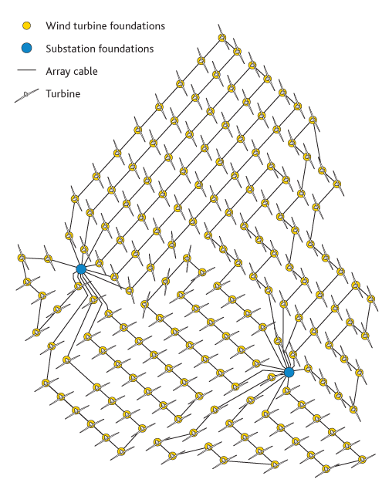
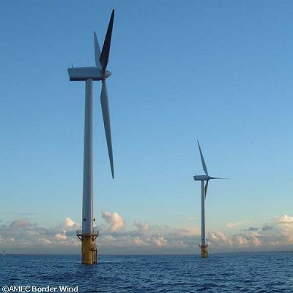
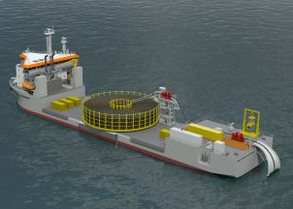
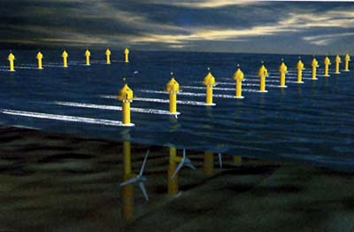
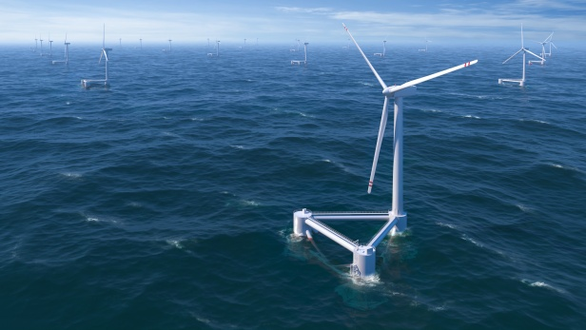
Examples of offshore renewable sites
Wind turbine generator sites
Hydrokinetic device sites
Substation platform sites
Cable routes

Slide 6
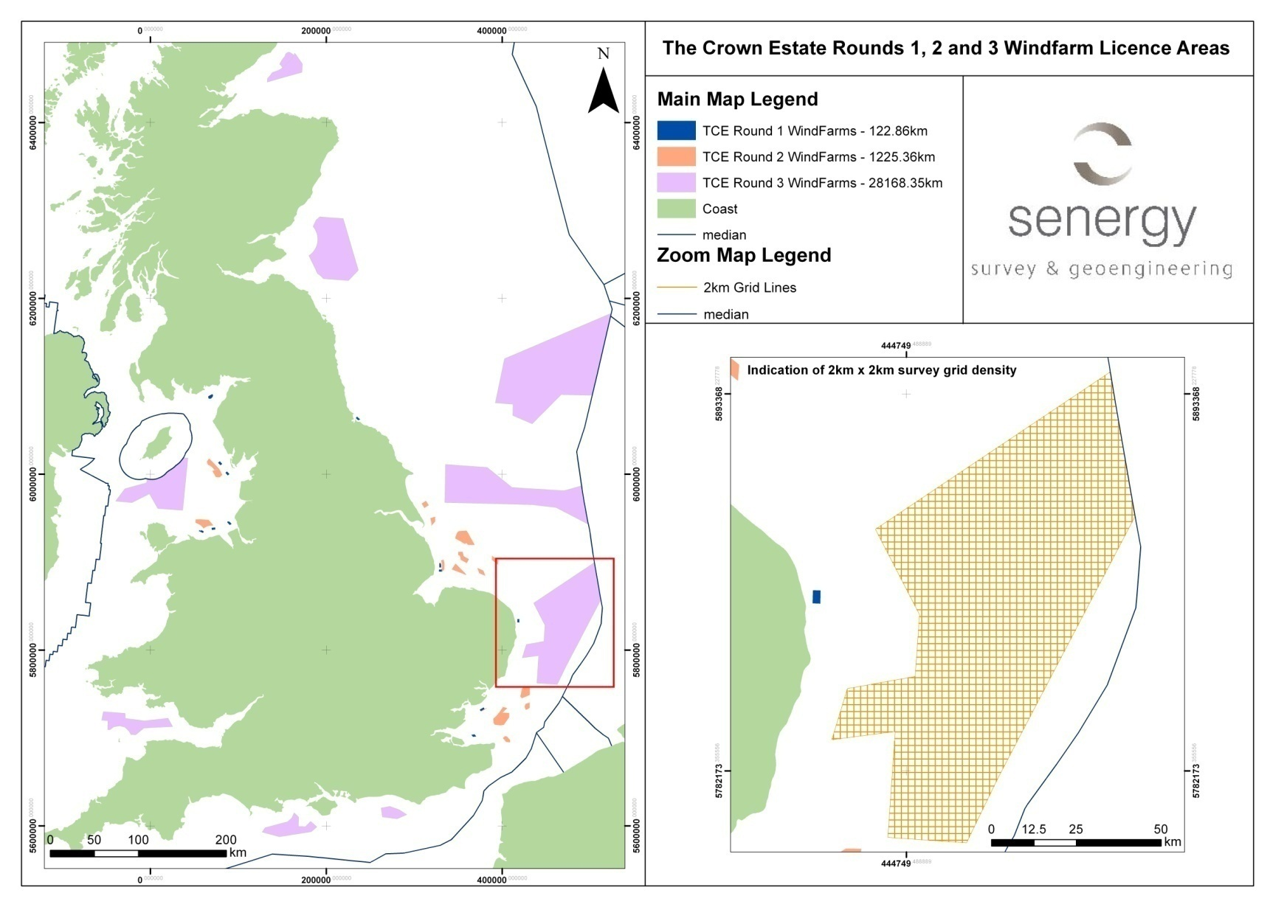
Oil & Gas vs Renewables- a question of scale (?)

Slide 7

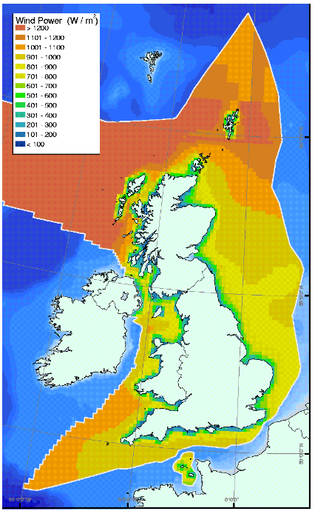
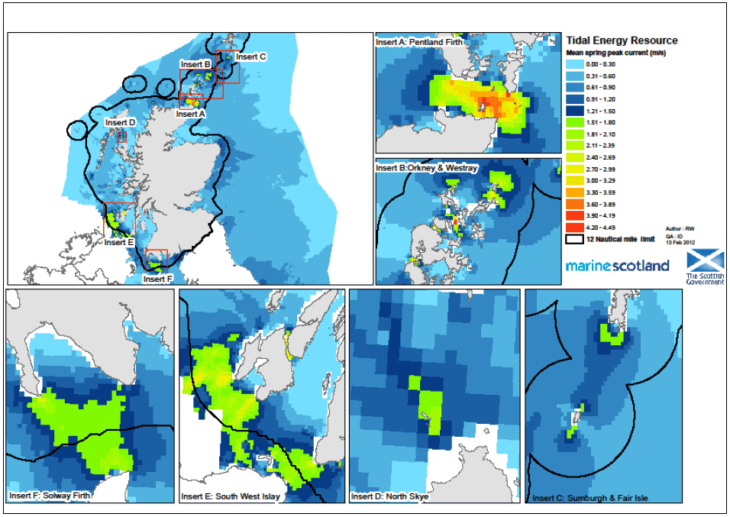
High energy…difficult sites

Slide 8
Guidance Notes: Objectives
To provide non-specialists with information on issues to be considered and practices to be adopted
To provide a framework for specialists
To aid survey planning & execution
To mitigate safety, environmental and commercial risks inherent in any offshore project

Slide 9
Guidance Notes: Guiding Principles
To aid cost-effective, fit-for-purpose offshore site investigation (geotechnics and geophysics)
Sufficiently generic to cover most offshore renewables developments
International
Reference to existing guidelines
Solely marine/offshore
Include in-field and export power cables
Learn from previous guidelines
Best practice

Slide 10
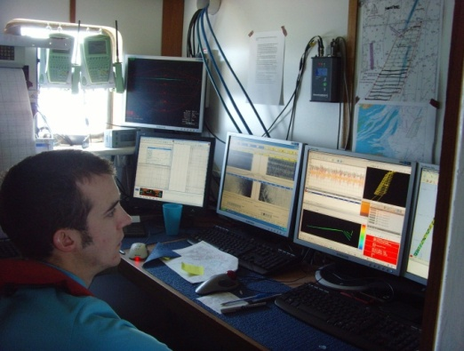
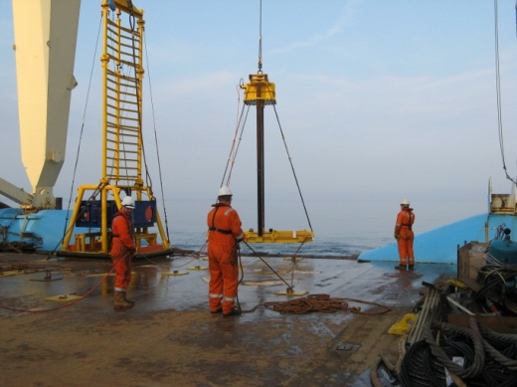
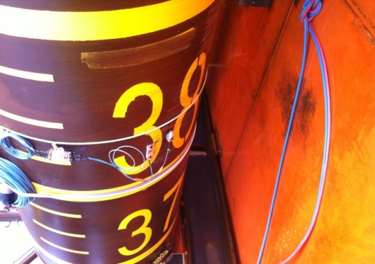
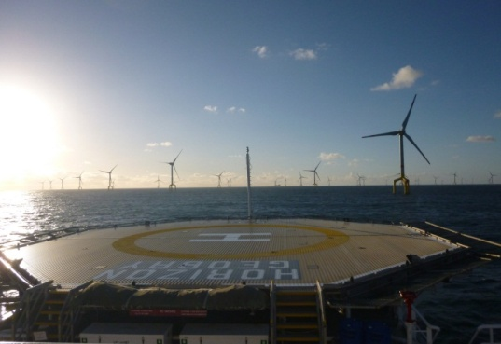
OFFSHORE SITE INVESTIGATION AND GEOTECHNICS COMMITTEE
GUIDANCE NOTES FOR THE PLANNING AND EXECUTION
OF GEOPHYSICAL AND GEOTECHNICAL
GROUND INVESTIGATIONS FOR
OFFSHORE RENEWABLE ENERGY DEVELOPMENTS
( May 2014)

Slide 11
Contents
Introduction
Part 1 - Planning
  Managing geological and geotechnical risk
  The ground model
  Planning and offshore ground investigation
Part 2 - Execution
  General
  Geophysical investigation
  Geotechnical investigation
  Positioning
  Data integration, interpretation & reporting
Glossary
Appendices
  References, Codes, Standards and Guidance Notes
  Geohazards
  Geotechnical testing methods

Slide 12
2 Part structure – Planning & Execution
Part 1 – Planning – this section presents a strategy that developers are recommended to follow in the planning of ground investigations and is aimed at practitioners with minimal experience of geophysical and geotechnical investigations.
Part 2 – Execution – this section presents key aspects that should be considered when performing such ground investigations. It is aimed at readers actively involved in the day-to-day management and application of ground investigations and is designed as an aide-mémoire.

Slide 13
Managing geological and geotechnical risk – Section 2
Central to project viability
  Costs
  Design
  Schedules
  Construction methodologies
  H & S
  Environmental issues
Reference to Clayton (2001) – why are ground related risks so high
Typical hazards

Slide 14
Hazards and their impact – Appendix 2

Slide 15
The ground model – Section 3
Iterative and continuous process throughout life cycle
Level of risk inversely proportional to level of knowledge
What is a ground model
Use of the ground model
Development of the ground model
Desk study
Ground investigation programme

Slide 16
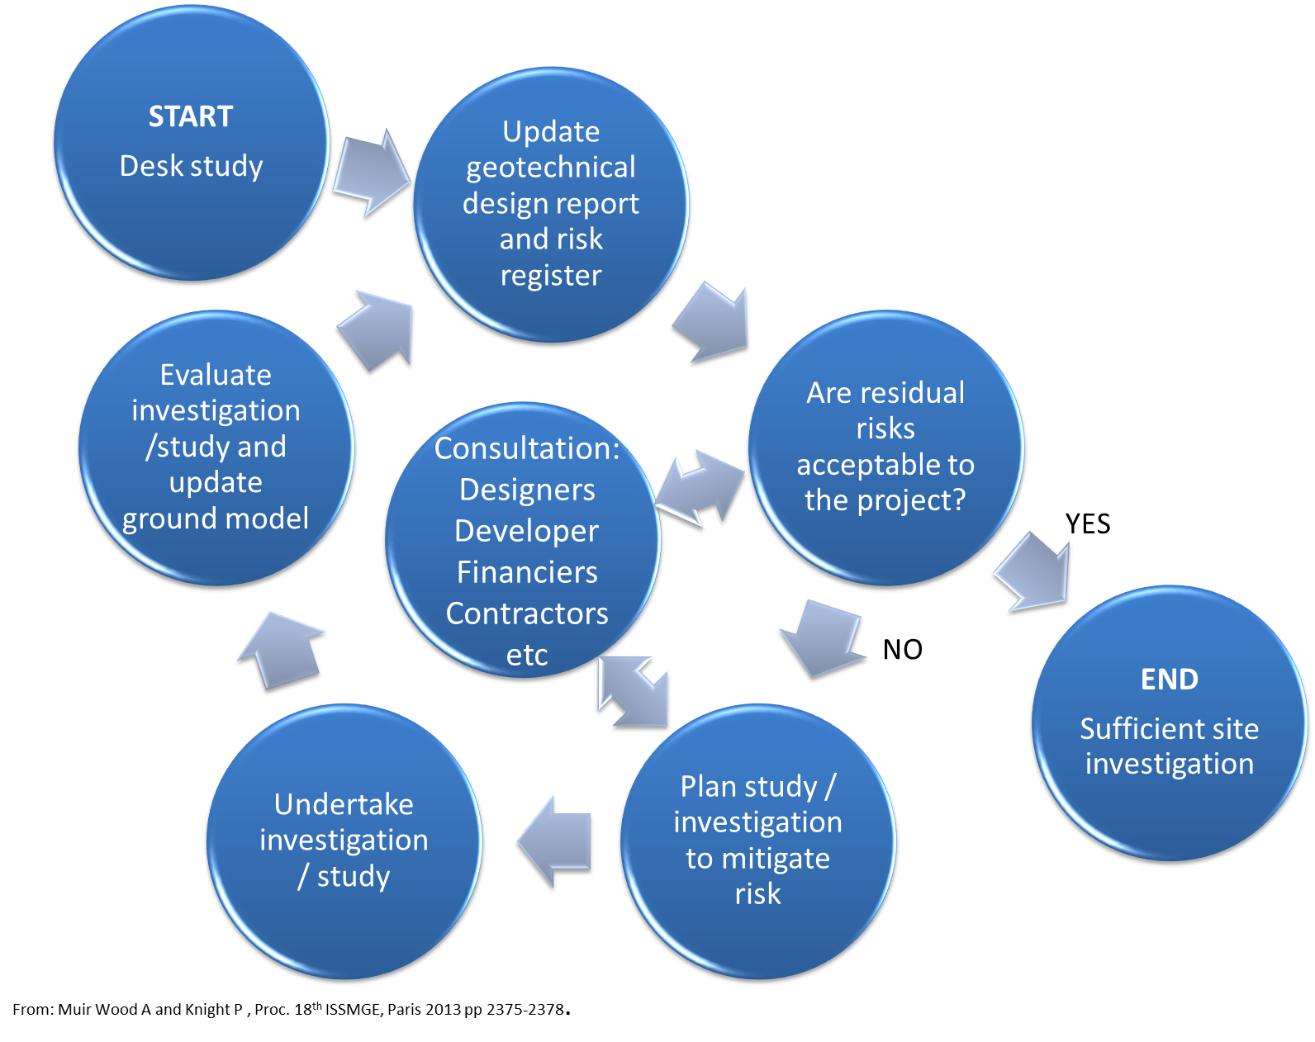
A typical process of understanding ground conditions – Figure 1

Slide 17
Example ground investigation process flowchart for an offshore wind development – Figure 2

Slide 18
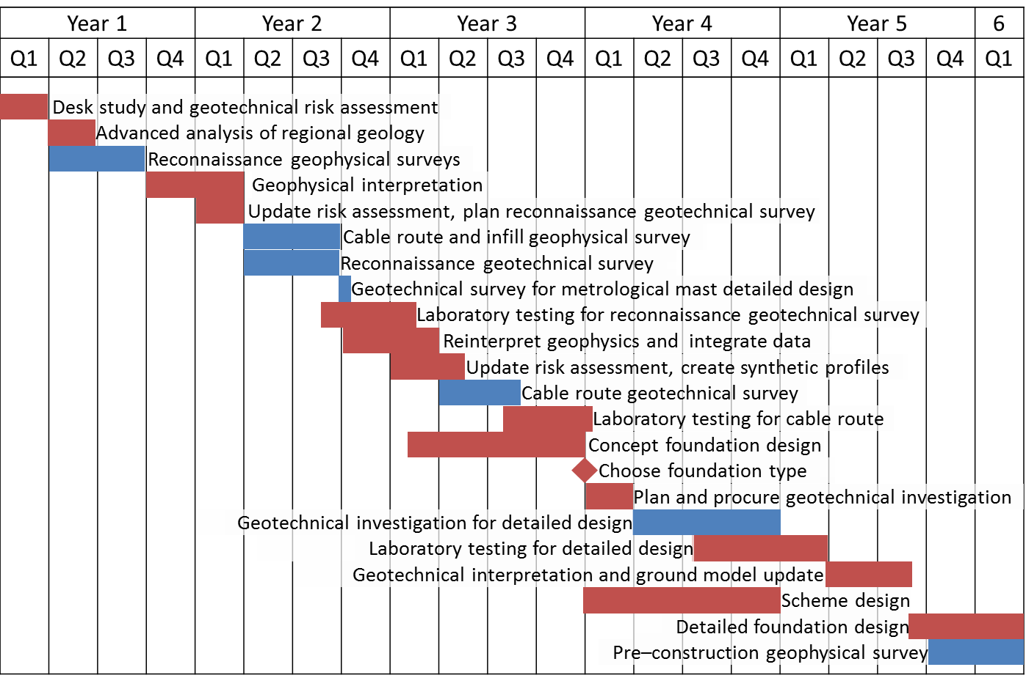
Example timeline for an offshore wind farm project. Site investigation phase – Figure 3

Slide 19
Planning an offshore ground investigation – Section 4
Aims and objectives
  End users/stakeholders
  Design codes/national standards
Type of investigation
Scope of investigation
  Generator and sub-station foundations
  Installation and maintenance
  Inter-array cables
  Export cables
  Shore crossings
  Data collection structures

Slide 20
Geophysical vs Geotechnical

Slide 21
Part 2 – Execution, General – Section 5
HS&E
Competent personnel
Developer’s representatives
Contractor and vessel/rig selection
Data and information management
  Geospatial data provision
  Standards
Offshore data processing, analysis and interpretation
Developer/contractor liaison

Slide 22
Geophysical investigation – Section 6
Reference to other guidance notes
Equipment used, application, operational issues and constraints
Sub-bottom profiling systems
Time/depth conversion

Slide 23
Schematic layout of geophysical equipment – Figure 4
Courtesy Osiris Projects

Slide 24
Geotechnical investigation – Section 7
Scope of geotechnical works
Advantages/disadvantages vessel/rig types – Table 4
Data coverage – example best practice geotechnical work scopes for different foundation types and construction vessels – Table 5
Geotechnical data requirements
Types of sampling and in situ test data – Table 6

Slide 25
Structure and foundation types – Figure 5

Slide 26
Positioning – Section 8
Use of GPS
Reference to existing guidance
Tidal reduction
In-water sensor positioning

Slide 27
Data integration, interpretation and reporting – Section 9
Holistic approach
Integration essential
Co-ordination over prolonged periods of investigation
Limitations
Report deliverables

Slide 28
Feedback/comments
Reviewers | Including
British Geological Survey
Certification Authorities/Warranty Surveyors | Bureau Veritas, DnV, GL, Global Maritime, Intertek, Lloyds Register
China Renewable Energy Engineering Institute
Consultants
Developers | DONG, EDF, E.On, Forewind, GDF Suez, Iberdrola, Mainstream, Scottish Power, RES, SSE Renewables, Statoil, Vattenfall
Engineering contractors/consultancies
OSIG | UK, USA, Australia (> 50 members)
Installers
RenewableUK
Survey Contractors
The Crown Estate
Universities

Slide 29
Acknowledgements and thank you
RenewableUK
The Crown Estate
China Renewable Energy Engineering Institute
OSIG
OSIG sub-committee
Lloyd’s Register

Slide 30
Guidance Notes
Free download from SUT web-site from Tuesday 15th July 2014:
  www.sut.org
Hardcopies available £15 per copy from SUT.

Slide 31

For more information contact:
www.sut.org
Or
OSIG sub-committee Chairman

